Slide 1

Austin Transportation Department Signs Work Orders
Created By: Susanne Gov Created Date: 2020-05-21 Location Name: 51ST ST / CAMERON RD Intersection ID: 5160982 Cardinal Direction: N
Sign Type | Install/Remove

Slide 2
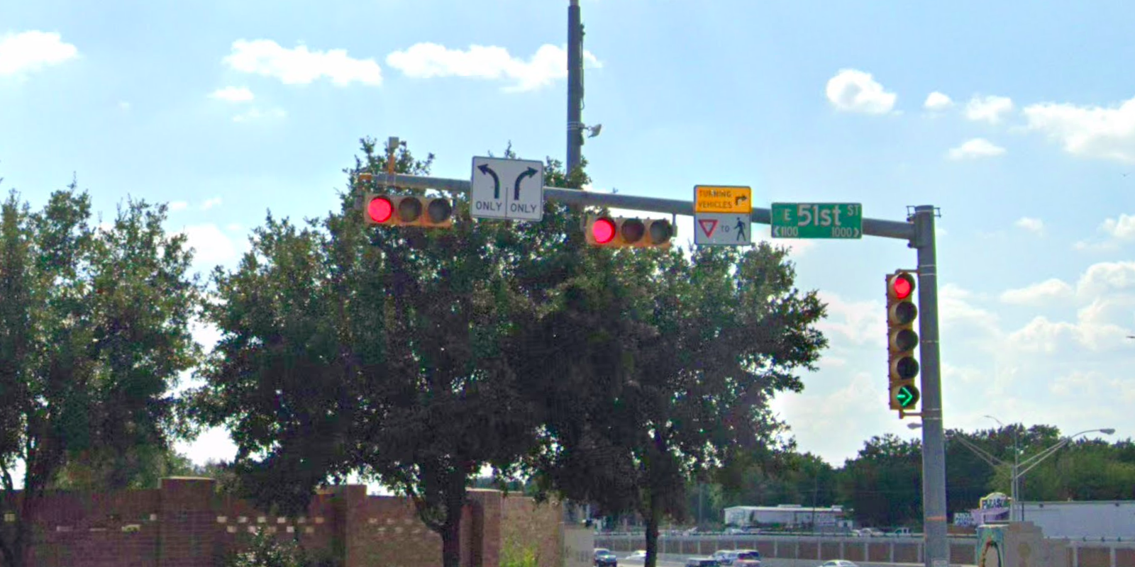
Austin Transportation Department Signs Work Orders
Created By: Susanne Gov Created Date: 2020-05-21 Location Name: 51ST ST / CAMERON RD Intersection ID: 5160982 Cardinal Direction: S
Sign Type | Install/Remove
Street Name Sign | Install
Left Turn Arrow Only | Install
Turning Vehicle Yield To Ped Symbol | Install
Right Arrow Only | Install

Slide 3
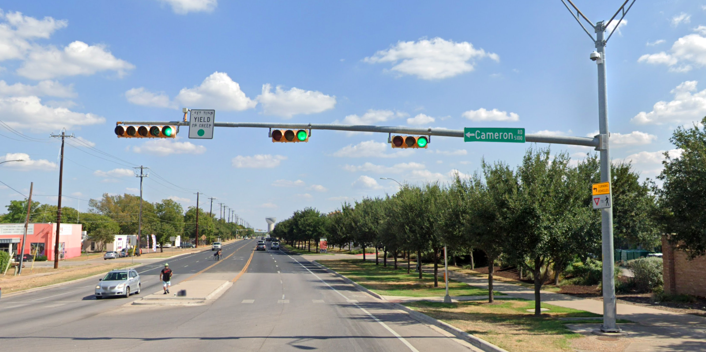
Austin Transportation Department Signs Work Orders
Created By: Susanne Gov Created Date: 2020-05-21 Location Name: 51ST ST / CAMERON RD Intersection ID: 5160982 Cardinal Direction: E
Sign Type | Install/Remove
Left Turn Yield On Green | Install
Street Name Sign | Install
Turning Vehicle Yield To Ped Symbol | Install

Slide 4
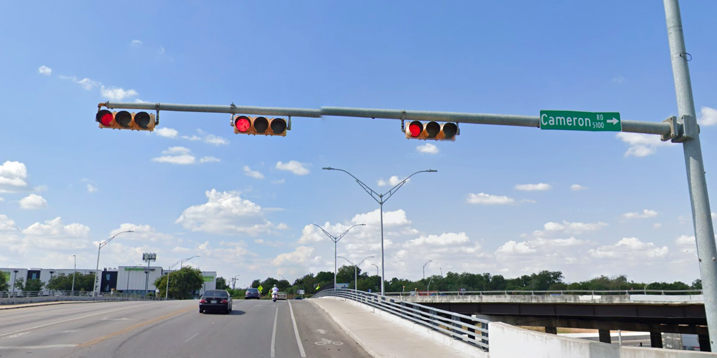
Austin Transportation Department Signs Work Orders
Created By: Susanne Gov Created Date: 2020-05-21 Location Name: 51ST ST / CAMERON RD Intersection ID: 5160982 Cardinal Direction: W
Sign Type | Install/Remove
Street Name Sign | Install

